Slide 1
Results Stabilization Drone

Slide 2
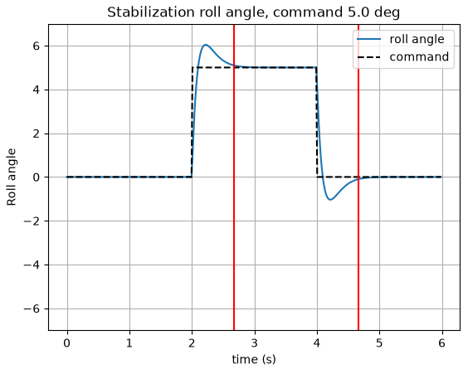
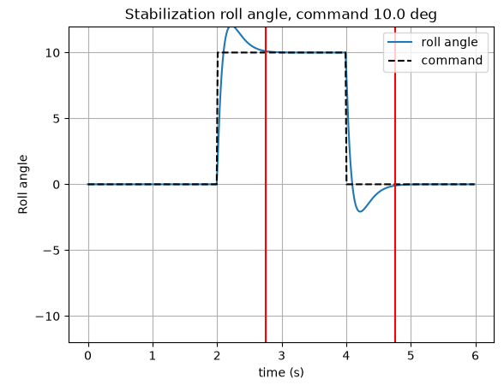
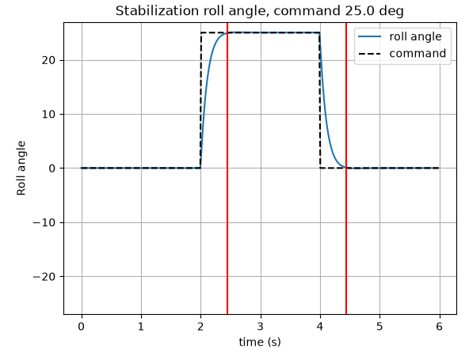
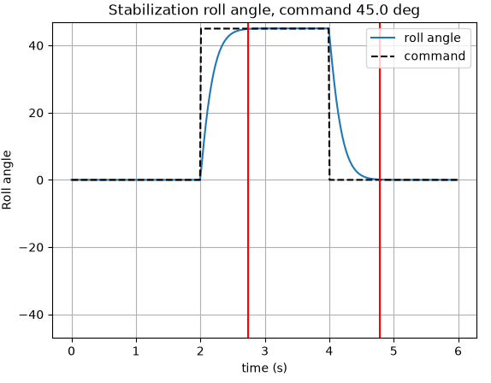
Roll angle stabilization Simulation
Problem :
Low angle (5 or 10 deg) : angle command exceeded
Coefficient | Values
Kp | 120,0
Ki | 0,8
Kd | 30,0

Slide 3
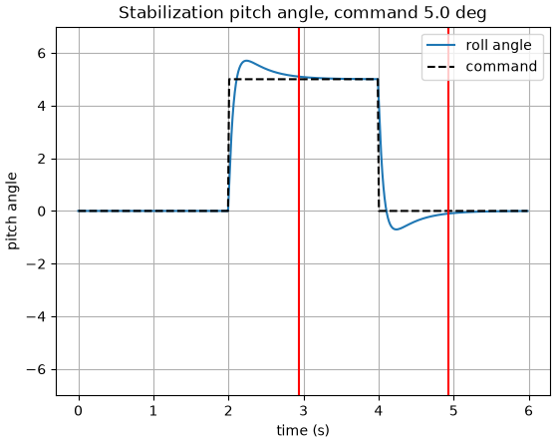
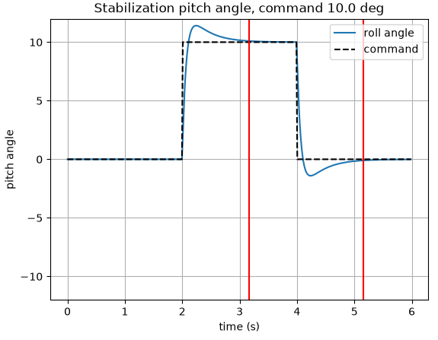
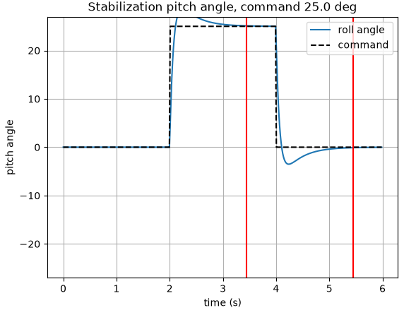
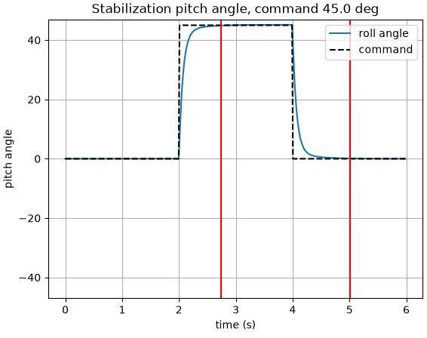
Pitch angle stabilization
Simulation
Problem :
Low angle (5, 10 and 25 deg) : angle command exceeded
Coefficient | Values
Kp | 30,0
Ki | 1,0
Kd | 12,0

Slide 4
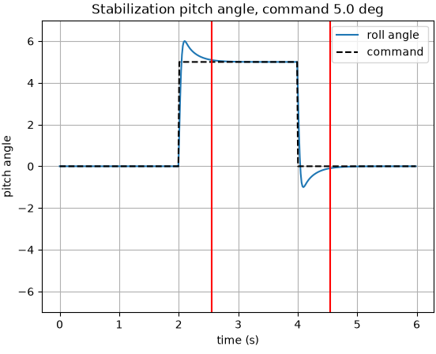
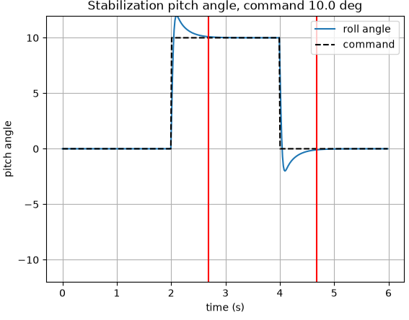
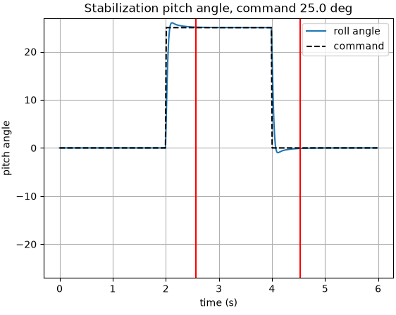
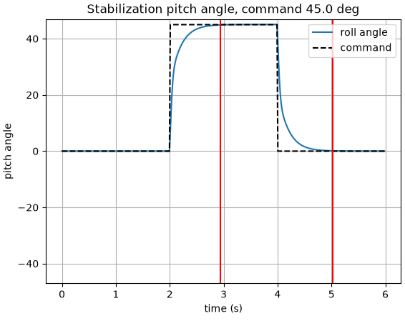
Pitch angle stabilization
Simulation
Problem :
Low angle (5 and 10 deg) : angle command exceeded
Coefficient | Values
Kp | 80,0
Ki | 0,8
Kd | 19,0

